Slide 1

MINI PROJECT – SEMESTER V
FINAL PRESENTATION
Dairy Management System
BY
120A3027
MOHD.RAFE
120A3031
PRATHAM NANAWARE
120A3049
RUSHIKESH
SHINDE
120A3062
VEDANT BOJJAVAR
UNDER THE GUIDANCE
OF
PROF. SMITA VHARKAT
Department of Information Technology
SIES Graduate School of Technology, Nerul

Slide 2

INDEX
INTRODUCTION
LITERATURE SURVEY
EXISTING SYSTEM
PROPOSED SYSTEM
HARDWARE AND SOFTWARE REQUIREMENTS
SYSTEM ARCHITECTURE(ER DIAGRAM,ETC)
APPLICATIONS
REFERENCES

Slide 3
INTRODUCTION
DAIRY MANAGEMENT SYSTEM PROJECT HAS BEEN DESIGNED ESPECIALLY FOR ALL THE INFORMATION RELATED WITH DAIRY PRODUCTS IS ENTERED AND WE CAN KEEP TRACK ON ALL THE PRODUCT TRANSACTIONS.
THE DAIRY MANAGEMENT SYSTEM IS A WEB BASED APPLICATION THAT WORKS AS A SIMPLE DIARY SOFTWARE TO MAINTAIN DAILY MILK RECORDS BY REGISTERED ACCOUNT MEMBERS,GENERATE STOCK AND MAINTAIN REPORTS.

Slide 4
EXISTING SYSTEM
THE MANUAL SYSTEM HAS MANY DISADVANTAGES LIKE:-
THE MANUAL SYSTEM REQUIRES MORE TIME FOR PROCESSING.
IT REQUIRES MORE CRITICAL WORK.
THE MANUAL SYSTEM IS MORE ERROR PRONE.
DIFFICULT TO MAINTAIN.

Slide 5
PROPOSED SYSTEM
PROPOSED SYSTEM IS REQUIRED BECAUSE OF SOME ADVANTAGES AS BELOW:-
REQUIRES LESS TIME FOR COMPLETION OF WORK.
IT DECREASES THE CHANCES OF ERROR.
IT SHOULD WORK SMOOTHLY AND FAST.
SAVES TIME AND REQUIRED MANPOWER.
IT IS USER FRIENDLY AND ANY ONE HAVING COMPUTER KNOWLEDGE CAN HANDLE IT EASILY.
SUITABILITY FOR COMPUTERIZED DATA ENTRY.
MAINTAINING DAIRY INFORMATION,CUSTOMER INFORMATION,MILK RATE INFORMATION.

Slide 6
OBJECTIVES
THE MAIN OBJECTIVE OF THIS SOFTWARE IS TO AUTOMATE THE COMPLETE OPERATIONS OF THE DAIRY DISTRIBUTORS.
TO REDUCE THEIR WORK AS THEY NEED TO MAINTAIN HUNDREDS OF RECORDS.
ALSO SEARCHING SHOULD BE FASTER SO THAT THEY CAN FIND REQUIRED DETAILS INSTANTLY.

Slide 7
HARDWARE AND SOFTWARE REQUIREMENTS
HTML
CSS
JAVASCRIPT
MYSQL
REACT JS
2GB RAM
STORAGE MORE THAN 16 GB
OS: WINDOWS 7

Slide 8
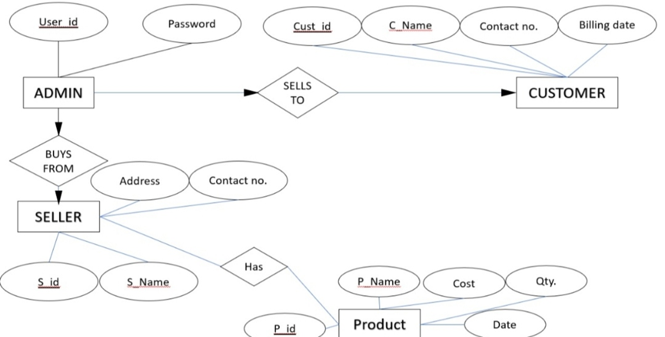
SYSTEM ARCHITECTURE(ER DIAGRAM)

Slide 9
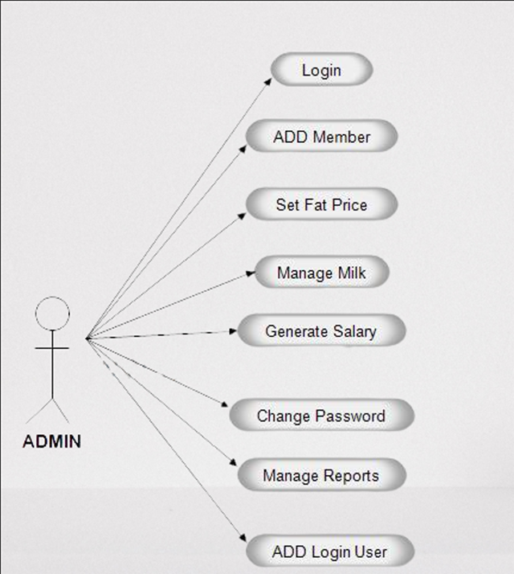
SYSTEM ARCHITECTURE(USE CASE DIAGRAM)

Slide 10
FEATURES
LOGIN FOR ADMIN
UPDATE MILK RATES
MANAGE CLIENTS
MANAGE STOCK
DETAILS OF PURPOSE
REPORTS SUMMARY OF MILK

Slide 11
REFERENCES
FUNDAMENTALS OF DATABASE SYSTEMS, ELMANSRI NAVATHE PEARSON EDUCATION.
AN INTRODUCTION TO DATABASE SYSTEMS, C.J DATE, A.KANNAN, S.SWAMI NADHAN, PEARSON, EIGHT EDITION FOR UNIT 3.
DATABASE SYTEM CONCEPTS, 6TH ED. SILBERSCHATZ, KORTH AND SUDARSHAN.

Slide 12
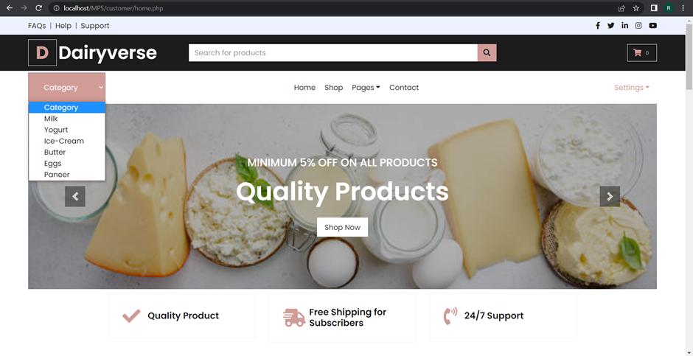
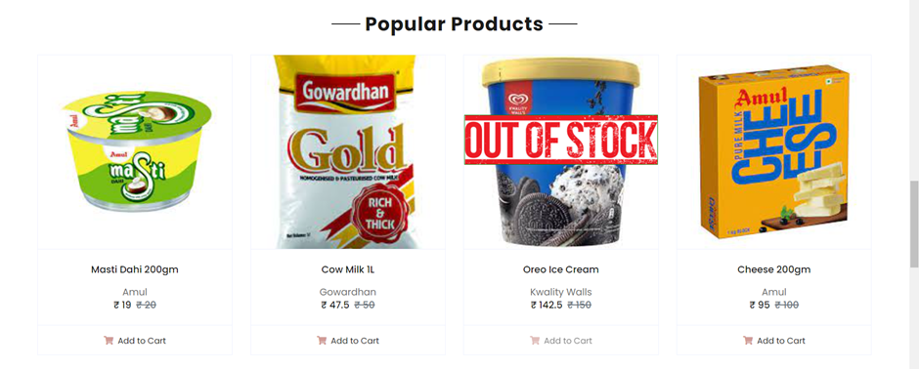
FRONT END

Slide 13
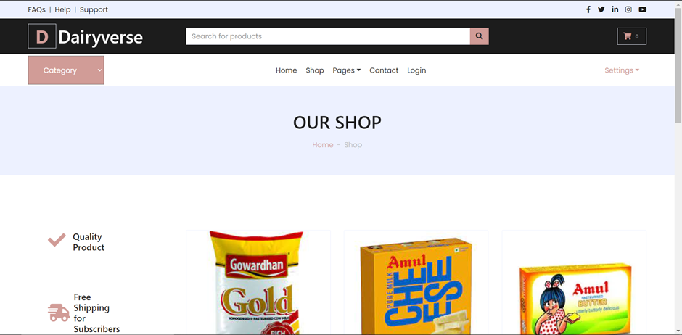
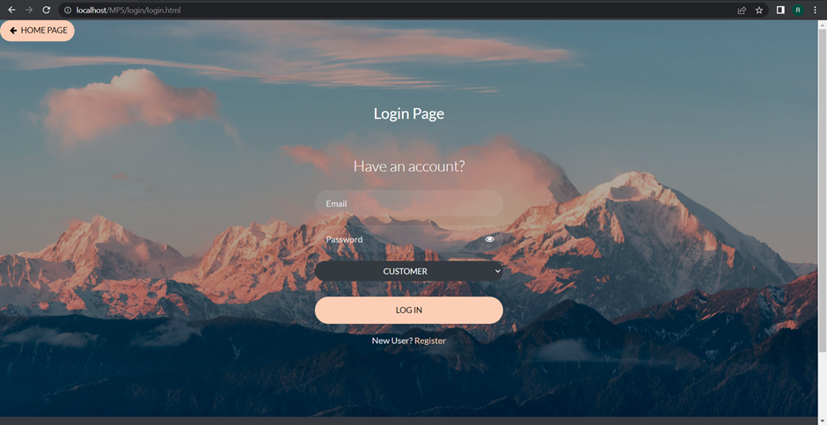

Slide 14
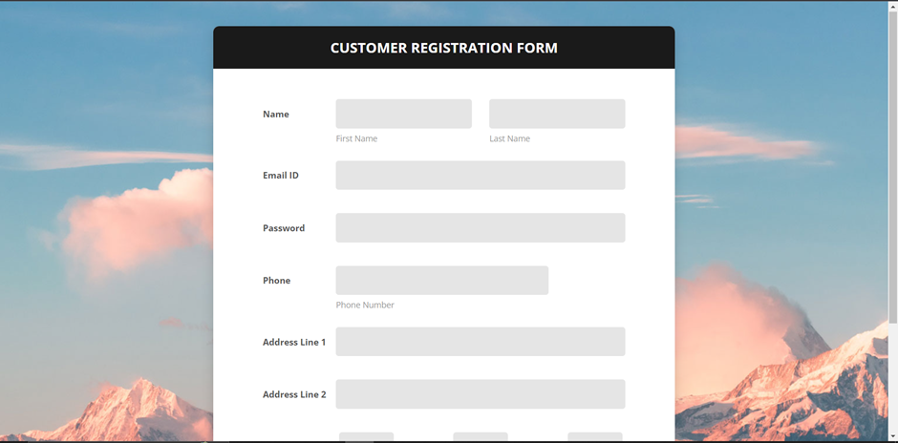
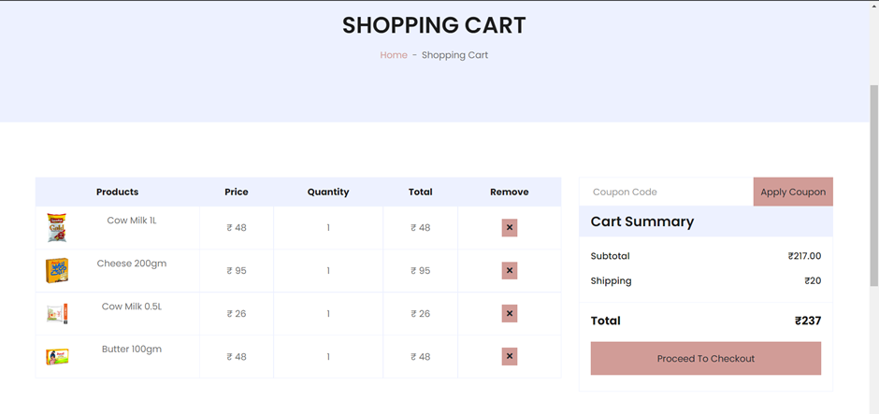

Slide 15
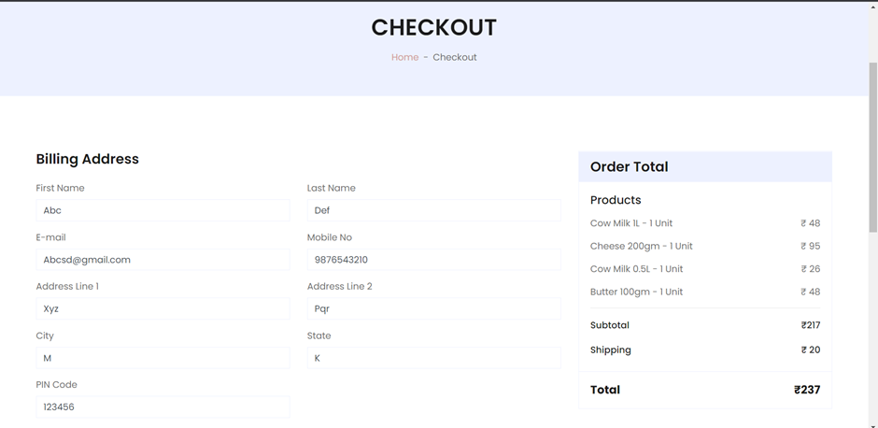
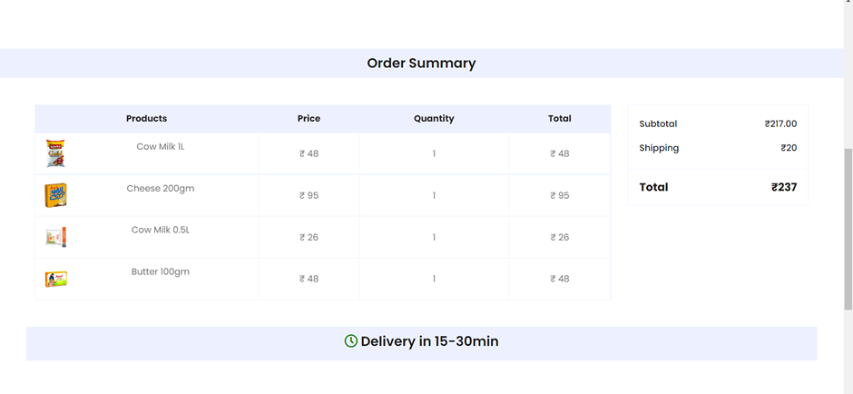

Slide 16
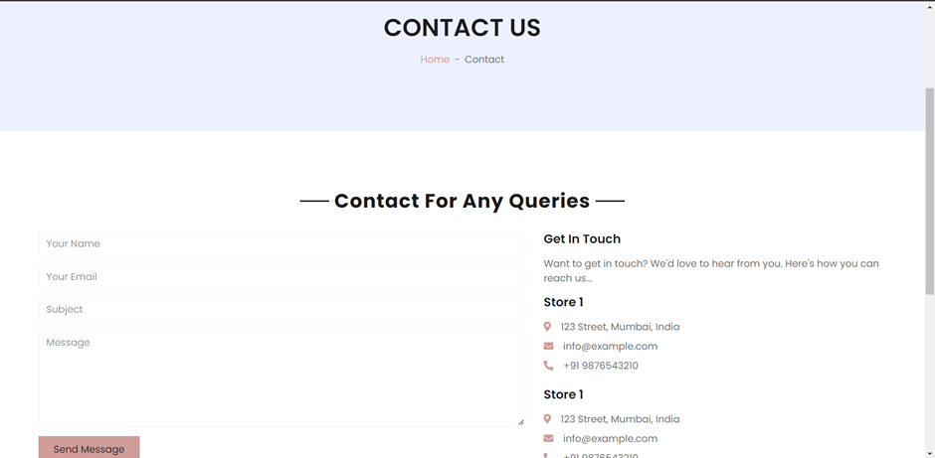
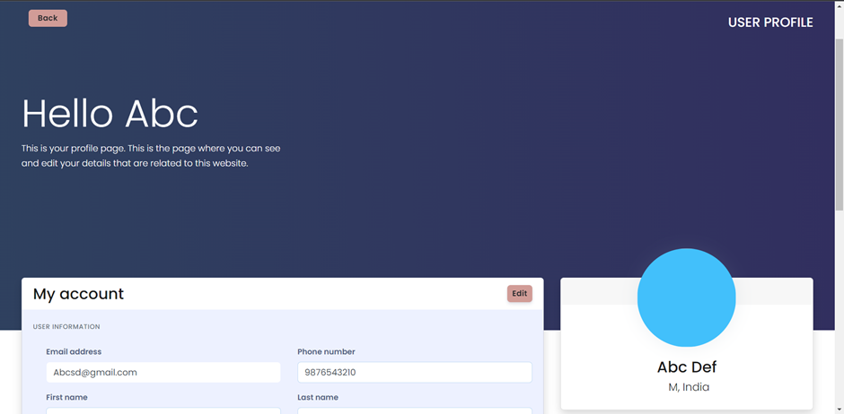

Slide 17
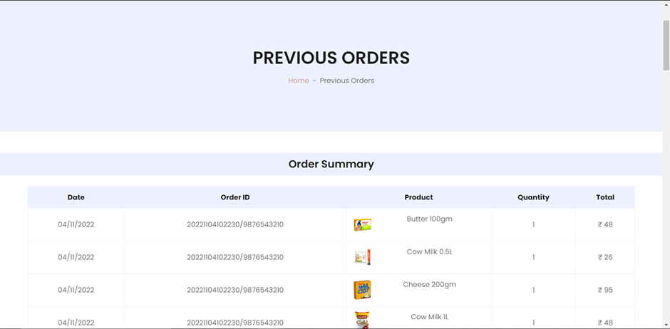
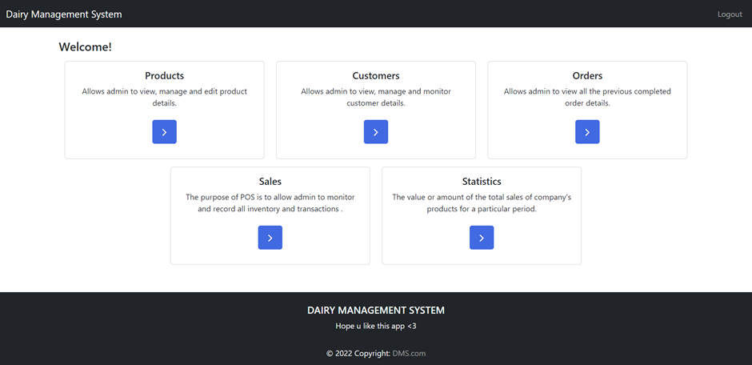

Slide 18
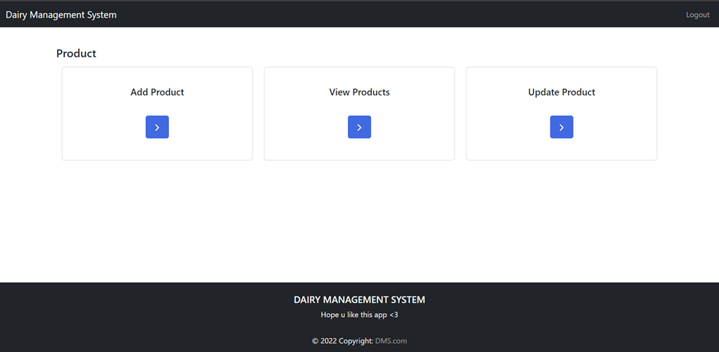
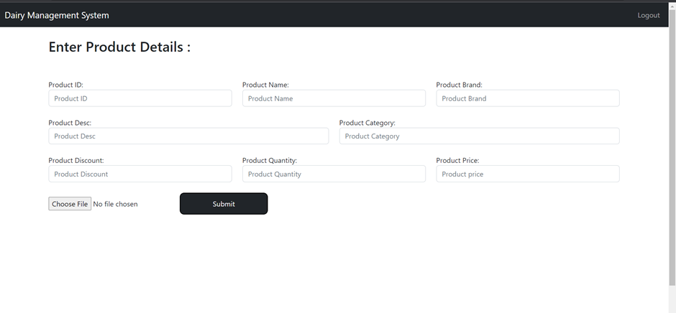

Slide 19
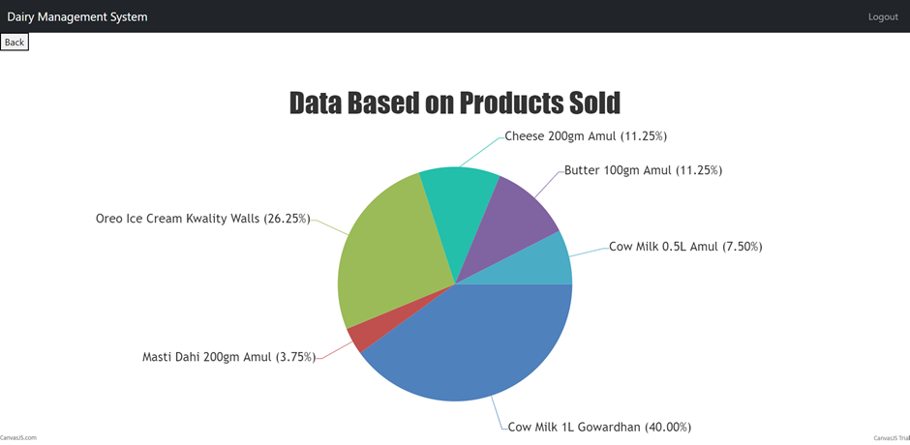
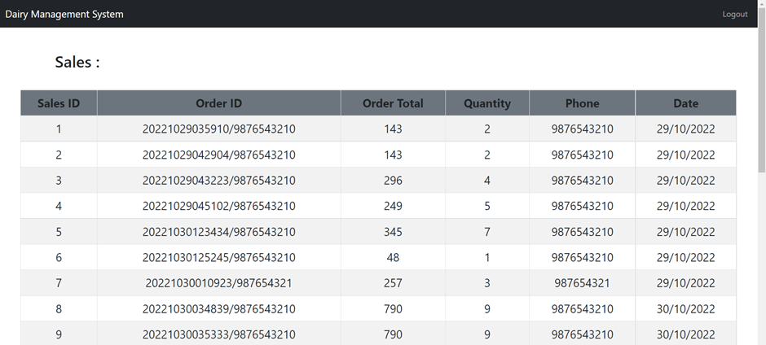

Slide 20
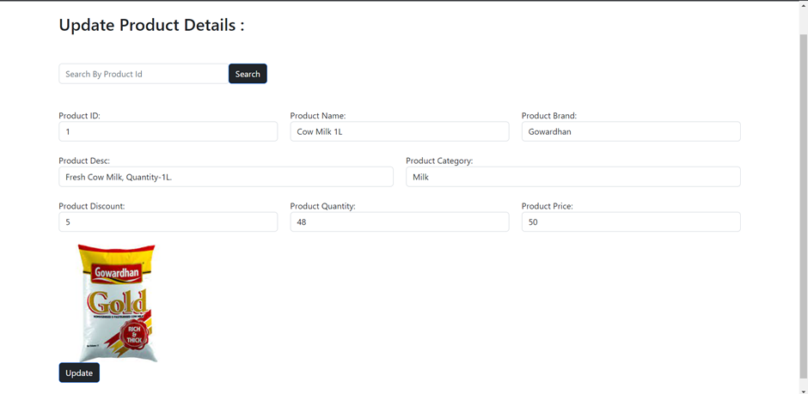

Slide 21
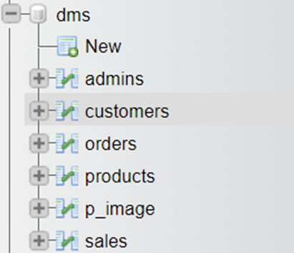
BACKEND:

Slide 22
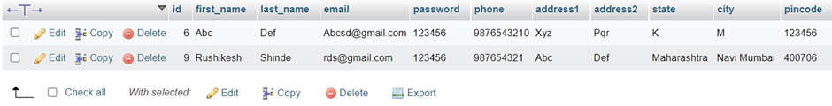
BACKEND(CUSTOMER):

Slide 23
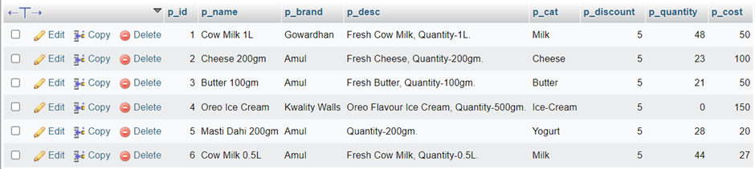
BACKEND(PRODUCT):

Slide 24
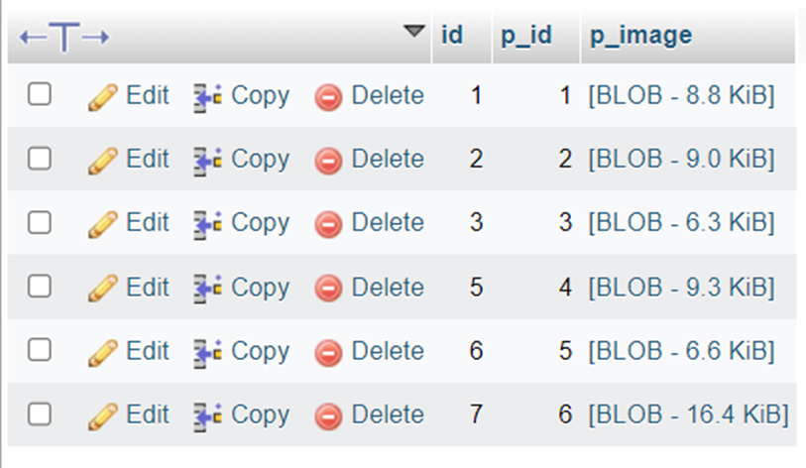
BACKEND(P_IMAGE):

Slide 25
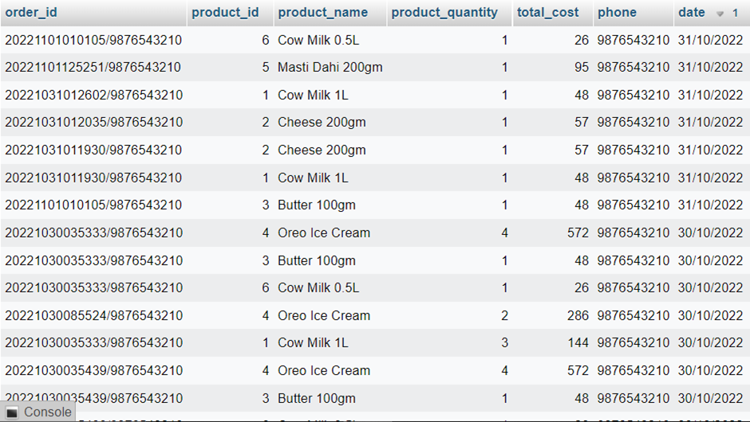
BACKEND(ORDERS):

Slide 26
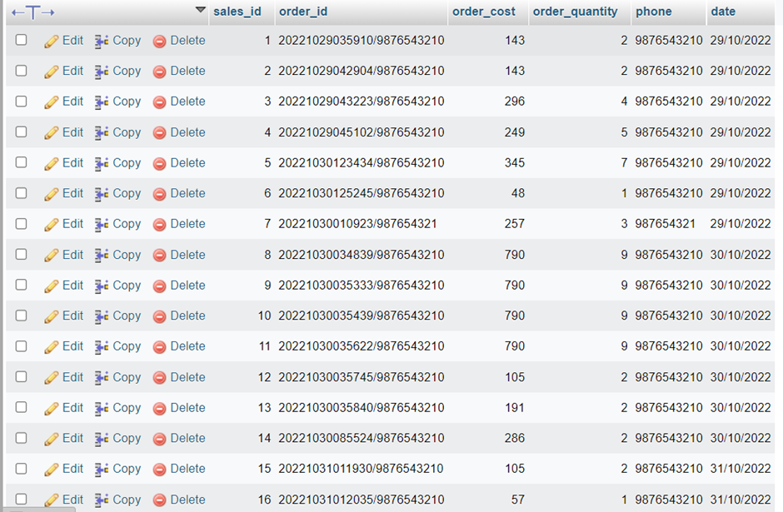
BACKEND(SALES):

Slide 27
THANK YOU

